Slide 1
EXPLORATORY DATA ANALYSIS ON EMPLOYEE ATTRITION
Team Number- 17
Abdullah Shad – Roll No: D22001
Agasthyakrishna Viswanthan Panicker - Roll No: D22002
Chetan Shastry - Roll No: D22013
Please find the Google collab link for Python Code:
https://colab.research.google.com/drive/1rPbIpkjk5GcENQPnL61YGuxfKFFL8i0L?usp=sharing#scrollTo=8e9a53e4

Slide 2
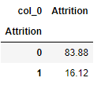
About Dataset, Problem Statement & Approach
The dataset consists of 20 variables and each variable conveys information about employees in the company.
Our goal is to find Major factors that are causing attrition.
With all the information at our hand we have applied univariate, bivariate and trivariate analysis to the dataset.
Type of features in dataset
Predictors
Numerical type of features
Age, Monthly Income Total working years Years at Company
Years in Current Role
Years since last Promotion
Years with current Manager
Distance from Home
Categorical type of features
Business Travel Department
Education Field
Environment Satisfaction
Gender, Job Involvement Job Level, Job Satisfaction Marital Status, Over Time Work Life Balance
Target Variable – Attrition
It is observed that the attrition rate of the company is 16.12%.

Slide 3
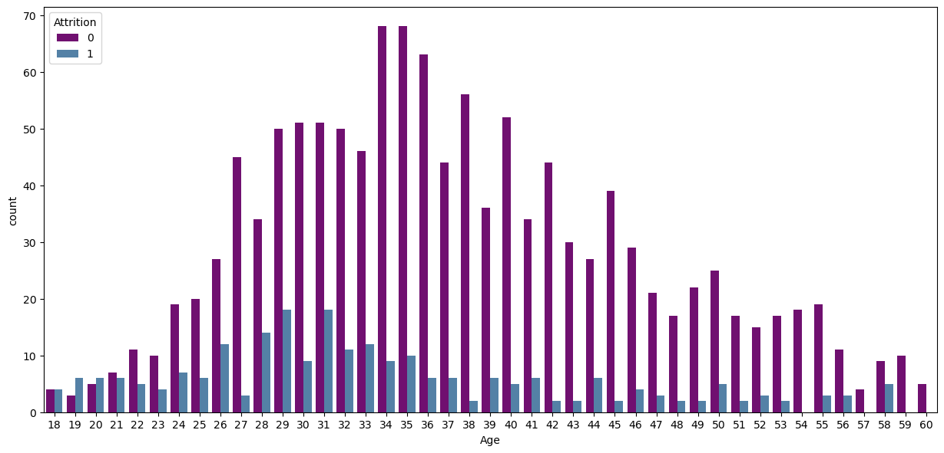
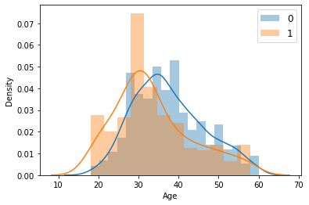
From Age POV
Interpretations :
The attrition is highest for the age group
28-32.
Probability of leaving the organization of an employee at low age is more than probability of staying, but this trend is reversed from age 33.
Attrition rate among the younger workforce is roughly 50%(in a particular age there are as many people staying as leaving), but as we move to the mid-age and old-age workforce this trend is not followed.

Slide 4
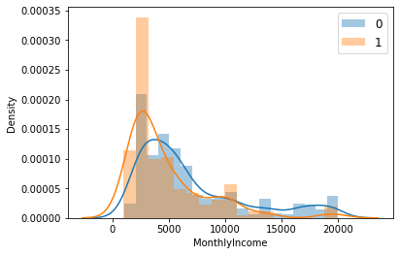
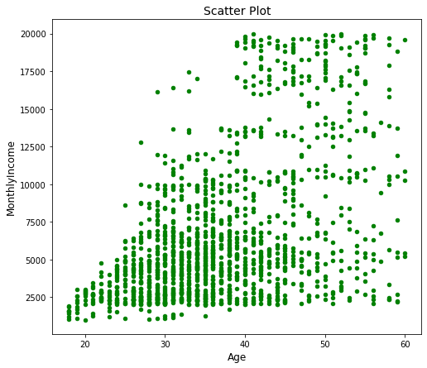
From Age & Monthly Salary POV
Interpretations :
When an employee’s monthly salary is low, the probability of leaving the organization is more than probability of staying, however as the monthly income reaches approximately 10000 the probability of staying in the organization is more than probability of leaving.
The maximum number of employees leaving the company are in the income range of 2000-3000.
It is evident from the scatter plot that very young employees(18-20) are on minimum pay-scale and that could be a reason that they have high probability of leaving.

Slide 5
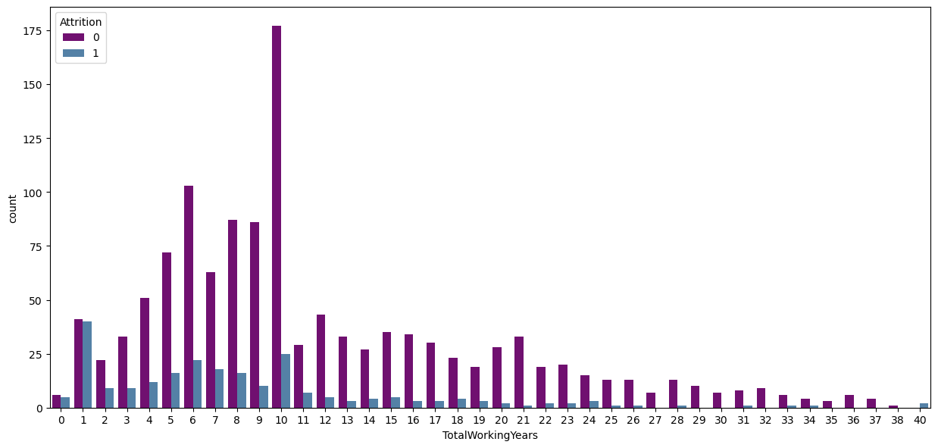
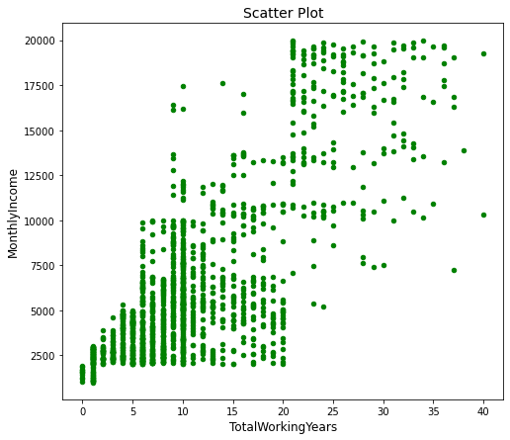
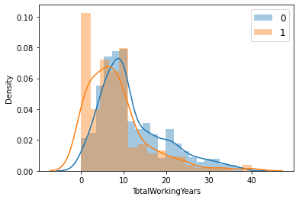
From Total Working years POV
Interpretations:
As a person's work experience is low, the probability of leaving the organization is more than probability of staying, but as the work-ex reaches approximately 8 years the probability of staying in the organization is more than probability of leaving.
It is evident from the histogram and scatter plot that the maximum number of employees leaving have 1 year of work experience and have low monthly income.
.

Slide 6
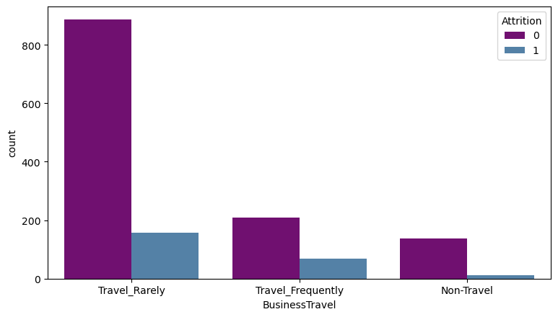
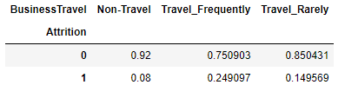
From Business travel POV
Interpretations:
It can be observed from the bar graph attrition is lowest among the employees who don’t travel.
From the conditional probability table, it is evident that the probability of leaving is highest for employees who travel frequently(0.24) and lowest for those who never travel(0.08).

Slide 7
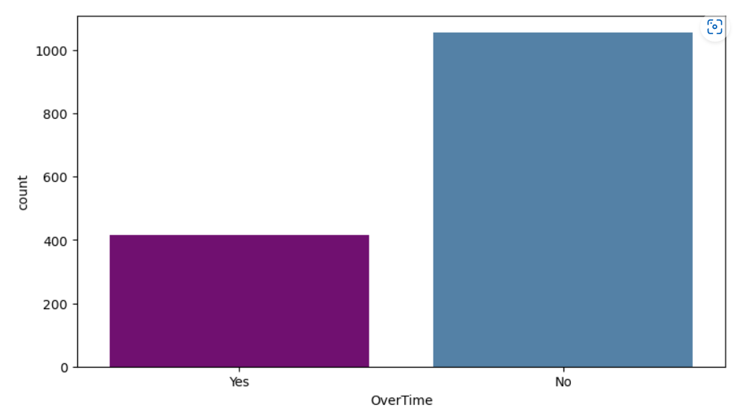
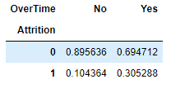
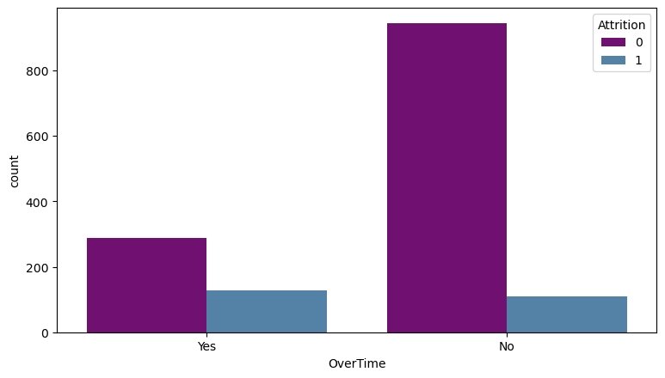
From Overtime POV
Interpretations:
Majority of the employees don’t work overtime.
Attrition is more for employees who work overtime.
From the conditional probability table, it is evident that given that an employee is working over-time, there is 0.30 probability that the employee will leave.

Slide 8
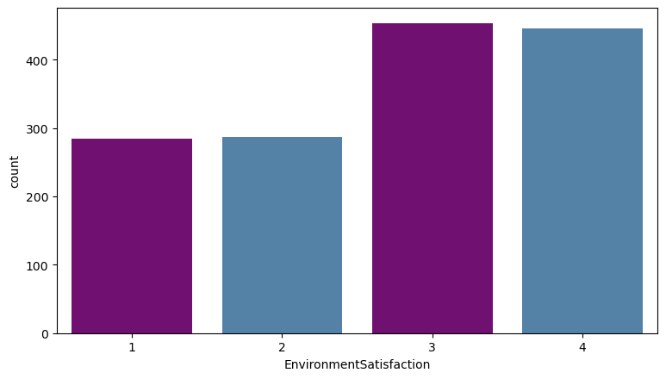
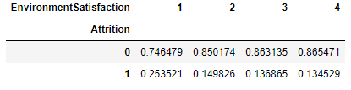
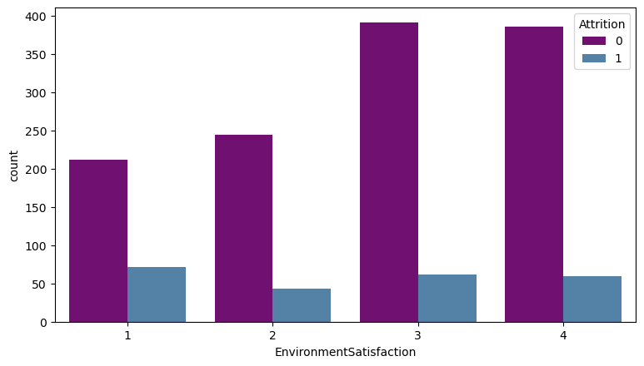
From Environment Satisfaction POV
Interpretations:
Majority of the employees in the company are satisfied with the work environment.
Maximum attrition is for employees who are not satisfied with the work environment in the company.
From the conditional probability table, we can say that given that a person is not very happy with the work environment(1), he/she has high probability of leaving(0.25).
For levels 2 ,3 and 4 the probability of leaving is almost equal hence only people who are very unhappy with environment tend to leave.

Slide 9
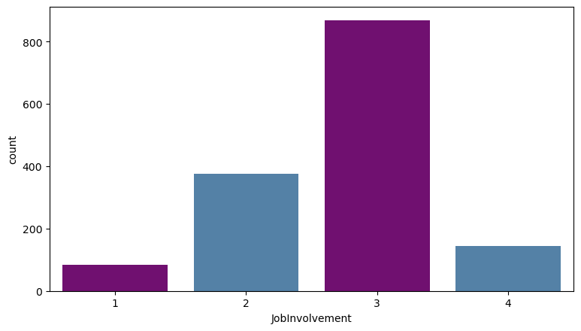
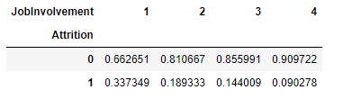
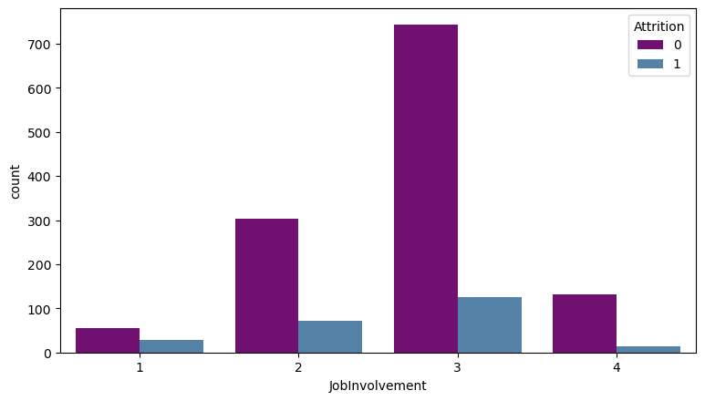
From Job Involvement POV
Interpretations:
It can be observed that majority of the employees in the company feel connected with their work.
From the conditional probability table, we can say that given that an employee who is not very much involved with the job (Level 1) has high probability of leaving(0.33).
From level 2 this probability decreases significantly and is least for employees who have job level 4.

Slide 10
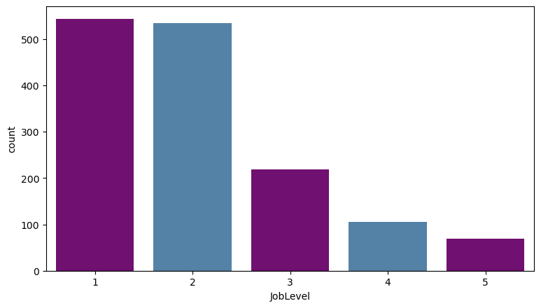
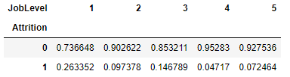
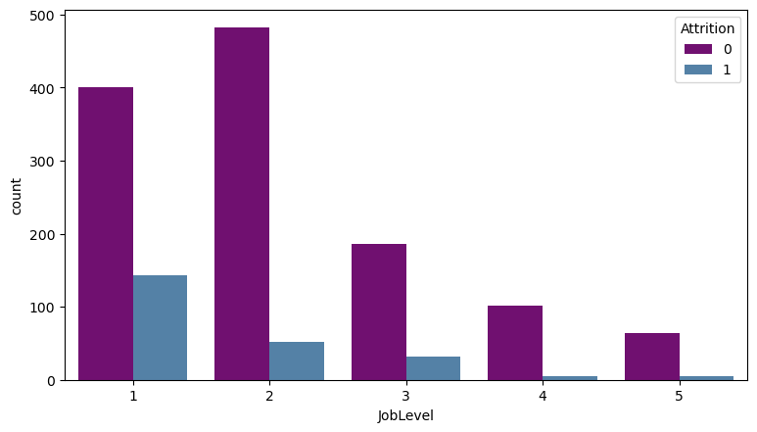
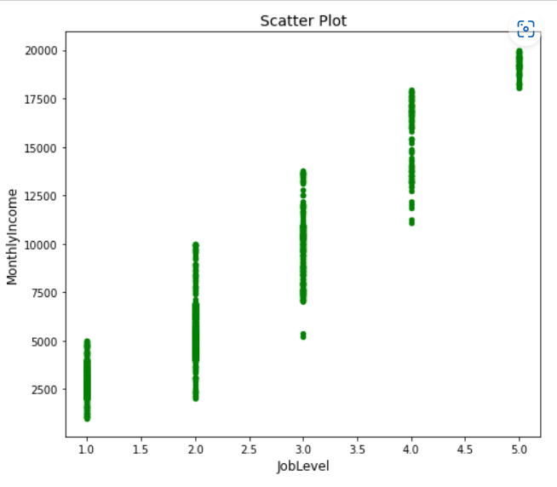
From Job Level POV
Interpretations:
Majority of the employees are in the job level 1. They could be low aged and low experienced.
Attrition is maximum in people who are in job level 1.
From the conditional probability table, we can say that given that an employee is in job level 1,he/she has high probability of leaving(0.26).
For levels 2 and 3 the probability of leaving is low(0.1 and 0.14) as compared to job level 1.
For job levels 4 and 5 the probability of leaving decreases significantly. So, employee who are at initial stage of career in this organization tend to leave.

Slide 11
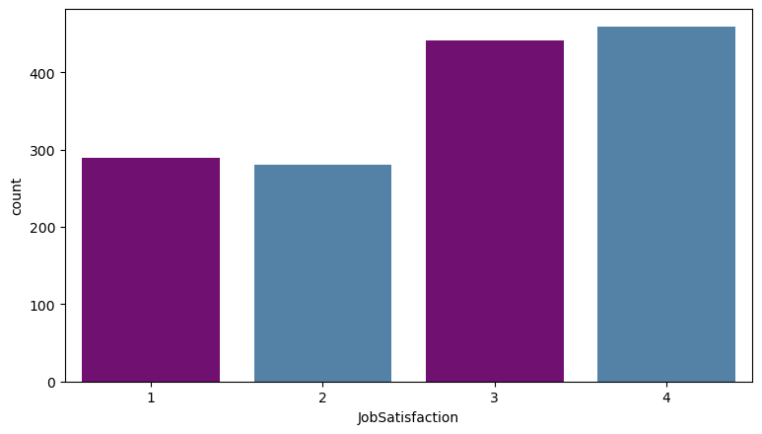
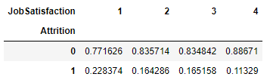
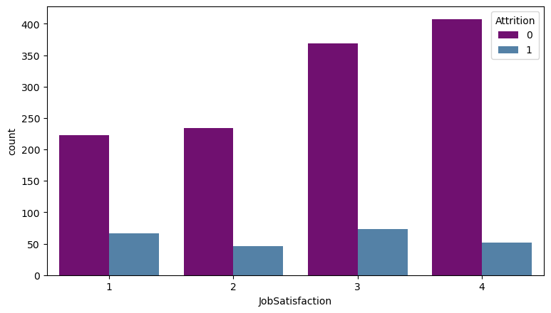
From Job satisfaction POV
Interpretations:
Majority of the employees are satisfied with their job.
From the conditional probability table, we can say that given that a person is very dissatisfied with the job(level 1), there is 0.22 probability that the person will leave the company. But as the job satisfaction increases the probability of leaving decreases.

Slide 12
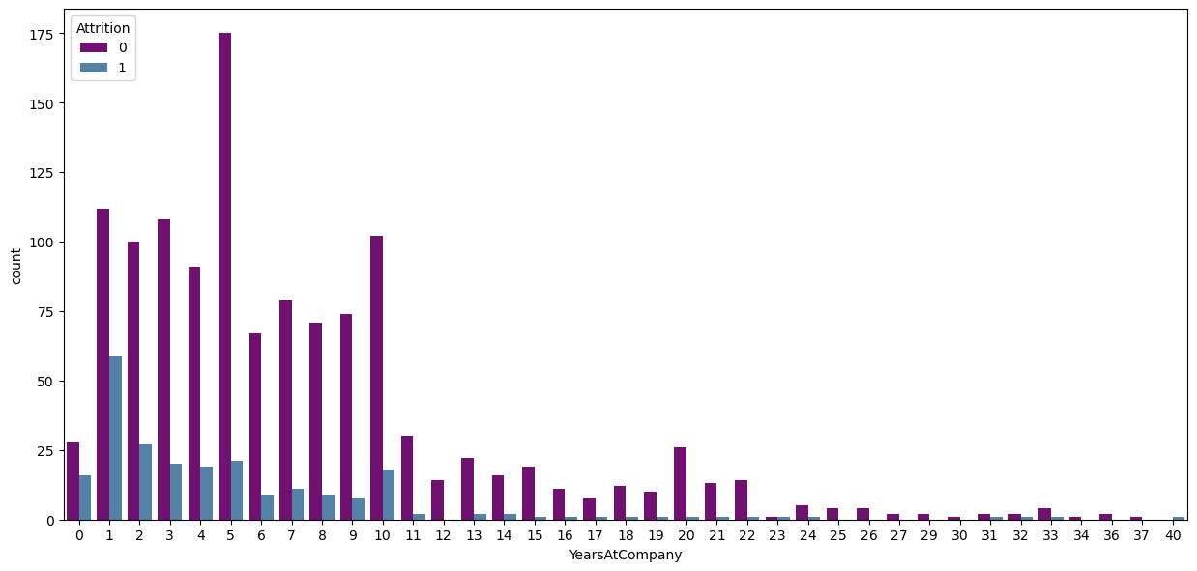
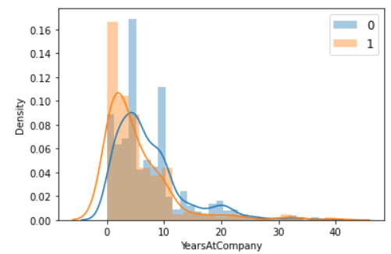
From Years at company POV
Interpretations:
Maximum attrition is for employees who have just worked for 1 year in the company.
The probability of leaving for employees who are new in the company is more than probability of staying. But as an employee completes around 5 years in the company this trend is reversed.

Slide 13
Possible reasons for attrition
Younger employees not satisfied with their wages.
Employees switching to get better opportunities and compensation.
Employees who are dissatisfied with their jobs are leaving the company
Employees are not happy with traveling as it could lead to time away from family.
Employees are not happy putting extra efforts outside of their work timings.
Employees who don’t like company environment leave the company.
Employees who don’t feel connected with their work leave the company.

